Slide 1
Strings

Slide 2
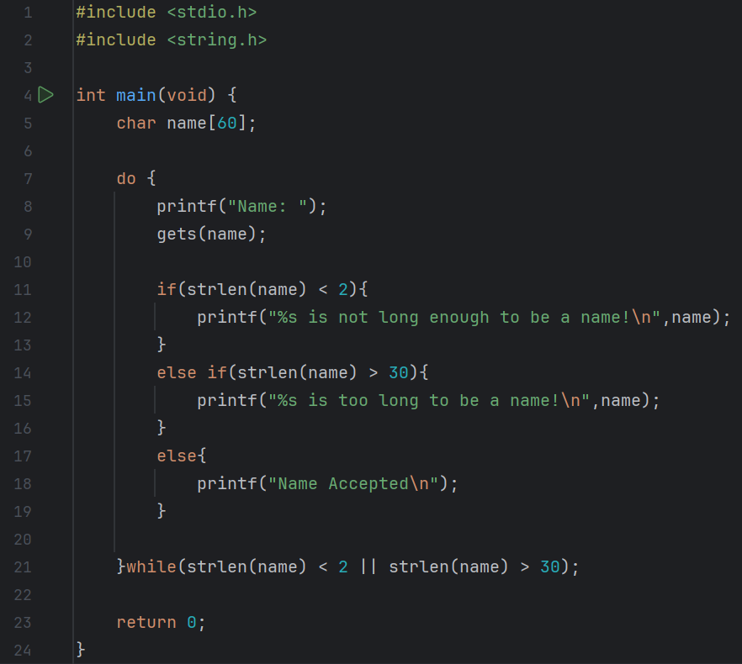
Predict
What do you think this code does?
Asks the user for their name. If it is less than 2 characters or more than 30 characters it outputs that it is too long or short. Otherwise it accepts the name.

Slide 3
Run
Download the code from Github and run it!
What does the code do?
Asks the user for their name. If it is less than 2 characters or more than 30 characters it outputs that it is too long or short. Otherwise it accepts the name.
Does this match your prediction?
Yes

Slide 4
Investigate
Investigation Activities
What is the name of the variable being used? name What data type does it hold? Characters, up to 60 of them Add comments to lines 4-21 to explain what each line of code does. What is the maximum name length? 29 What does fflush(stdin) do? Clears the output buffer

Slide 5
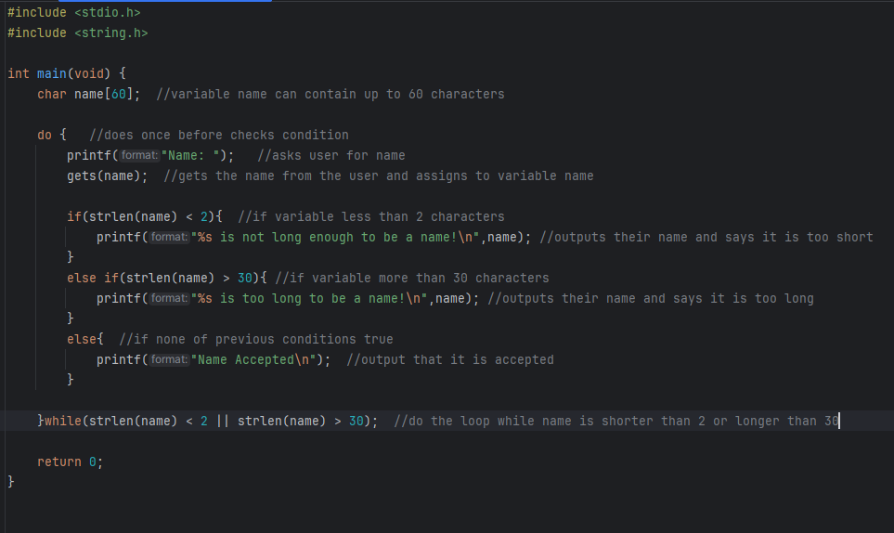

Slide 6
Modify
Modification Activities
Change the messages being displayed. Adapt the code to accept names up to 35-character names. Add an additional output in the case that the name is exactly 6 characters long.

Slide 7
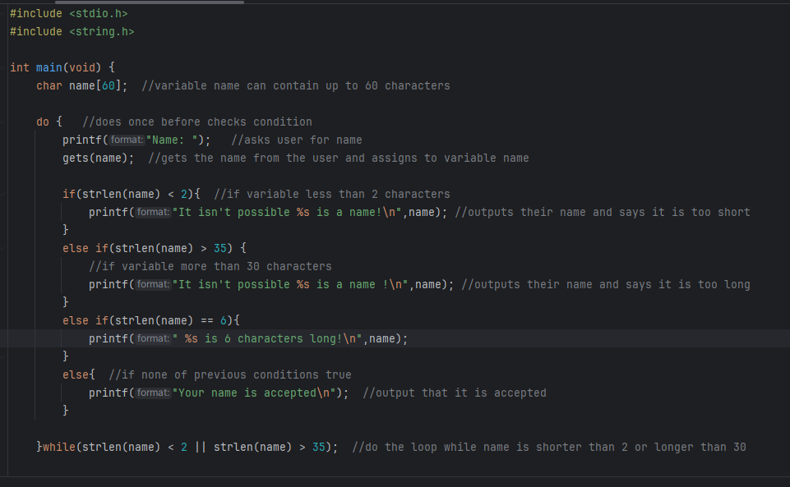

Slide 8
Make
Make Activities
Write a program that will read in a list of five words and store them in a 2D array It should run through the words and find which word comes first in the alphabet, and output this to the user.

Slide 9
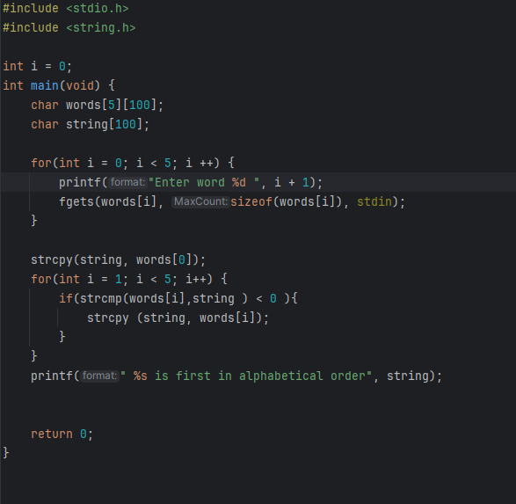

Slide 10
Make
Make Activities
Write a program that: Asks the user for two strings Asks the user for a character Counts how many of that character is in both strings Outputs: The total character count e.g. There are 7 e’s Which of the two strings has the highest occurrence of that character in it e.g. String 2 has more e’s in it (4)

Slide 11
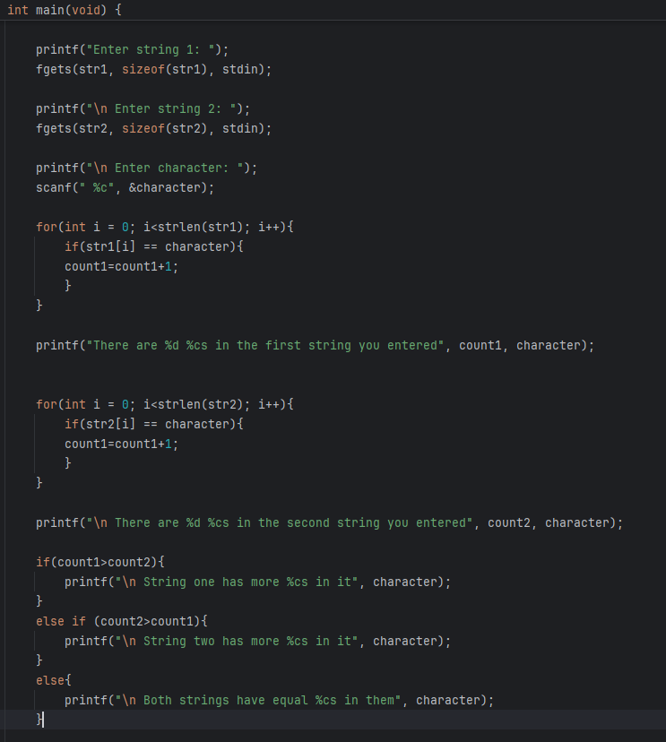

Slide 12
Make
Make Activities
Write a program to get a string as an input The program should output the string, with all the vowels removed.

Slide 13
